Slide 1
ZERONE bot
Presented by
S.SRIRAM

Slide 2
ZERONE bot
Zerone bot [chatbot] can simulate conversations with the end-users.
The end-user can ask/query anything with this application and the Zerone bot will automatically respond accordingly to the queries/questions.

Slide 3
Zerone bot
The program has an admin panel where can admin user of
this web application will feed the responses for the possible questions that users may ask/query to the chatbot.
The admin panel has many features that are related to the chatbot information.

Slide 4
ZERONE bot
The admin user can also manage some other details of the chat boot such as the welcome message, no result message for the query, and avatars.
Talking about the chatbot responses, the admin will store information in the system and will tag the possible question for that response

Slide 5
ZERONE bot
The system also stores the questions that no answers can be found in the database. By this, the admin can check if the questions are relevant to the site.
And if does, the admin user can create a response for that query.

Slide 6
ZERONE bot
Front-End (coding)
HTML5
CSS
Back-End
(data base)
MySQL Database

Slide 7
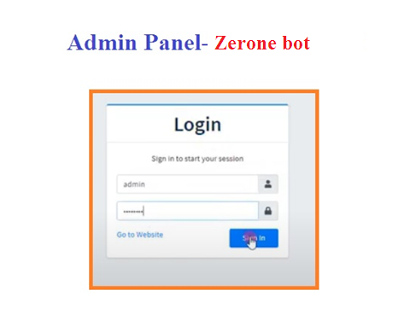
Login portal

Slide 8
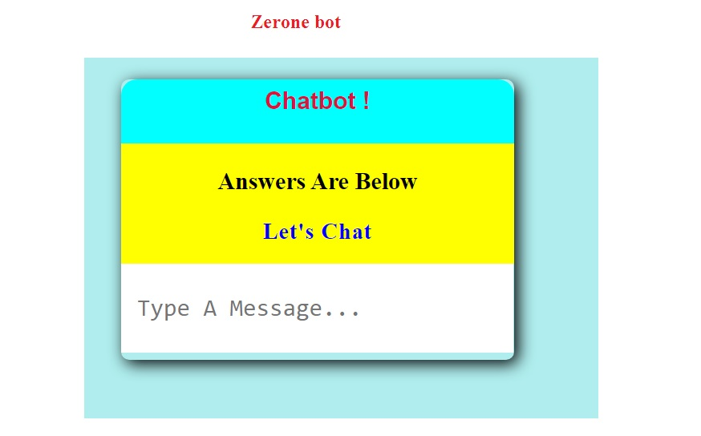

Slide 9
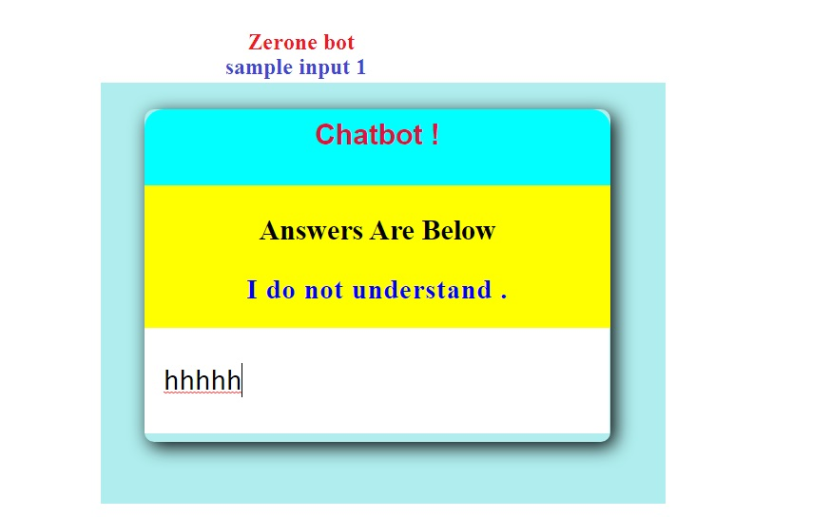

Slide 10
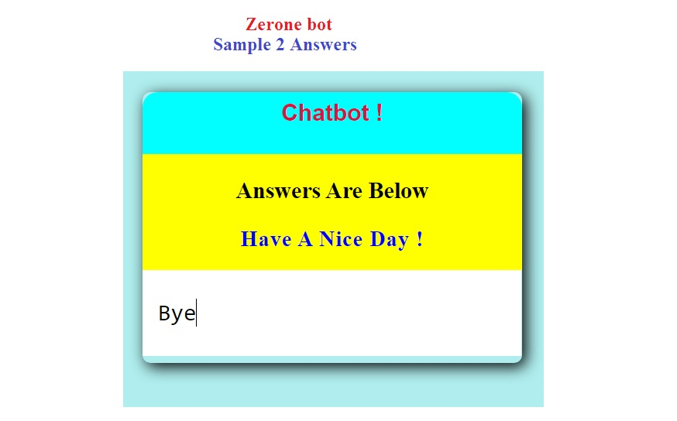

Slide 11
Sample output

Slide 12


